Slide 1
SCI Day of Science and Careers
Being a patent attorney
Darren Smyth
Partner, EIP
dsmyth@eip.com

Slide 2
A bit about me
1988-1996 New College, Oxford University
MA Natural Sciences (Chemistry) – Part II on rearrangement of allylic sulfones
DPhil under supervision of Professor Steve Davies – asymmetric synthesis
1996-1998 JSPS/Royal Society post-doc at Tokyo Institute of Technology in laboratory of Professor Koichi Mikami (more asymmetric synthesis)
1998-2011 Marks & Clerk – qualified as UK and European patent attorney in 2001, became partner in 2003
2012-present – EIP – head of EIP Elements
Notes:
Getting more informal (dress like a lawyer only when people expect it)

Slide 3
What is a patent attorney?

Slide 4
A patent attorney is
  A lawyer
  Specialised in the legal protection of inventions
  Mostly obtaining protection
    Drafting patent applications
    Arguing with patent offices
  Also advising on rights, eg licensing, freedom to operate
  And enforcement of rights, eg litigation (although also consider solicitor as a career if that is what you want to do)

Slide 5
You get to work with
  Inventors and research teams
  Commercial and marketing teams
  Patent attorneys in other countries
  Patent examiners at UK and European Patent Offices
  Other lawyers (solicitors, barristers)

Slide 6
What do you need?

Slide 7
Essential and desirable qualifications
  A science or engineering degree
  Further degree is optional, but not unusual
  Proficiency at written English
  Foreign languages an asset
  Attention to detail
  Good communication and analytical skills

Slide 8
Getting into the profession
Basically two kinds of role – in-house or private practice
In-house – likely to be more narrowly technically focused and more commercially focused – your “client” is internal
Private practice – wider range of subject matter, range of clients
IP departments and patent attorney/IP law firms are small – may take on 0, 1 or 2 chemists per year
Research experience is useful, but don’t do a PhD just for that if you know what you want to do
Notes:
It’s getting harder as the profession is becoming better known
Internet means you need to know a lot about the profession and the entity you are applying to before you apply
Private practice considered better for training – easier to learn with a diverse practice base

Slide 9
Qualification route
  Must be done under supervision of patent attorney (patent attorney firm or in-house department)
  First level exams – Patent Examination Board or University course (Queen Mary, Bournemouth)
  Final UK exams
  Two sets of exams for qualification before European Patent Office – exam and “pre-exam”
  Expect to take 4 to 6 years
  Involves large amount of private study and for many their first experience of exam failure

Slide 10
Not all patents are complicated

Slide 11
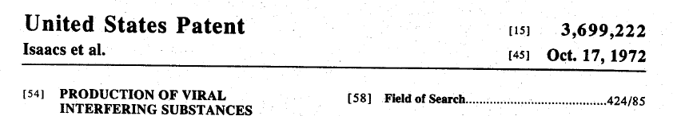
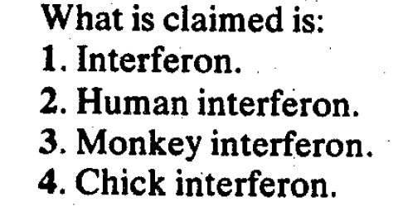


Slide 12
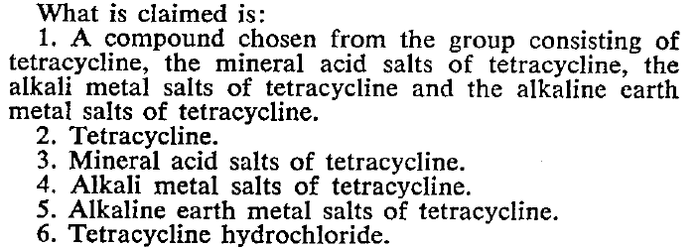

Slide 13
US 2,230,654

Slide 14
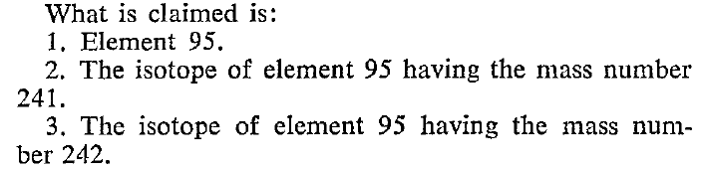
Notes:
Americium

Slide 15
But often they are…

Slide 16
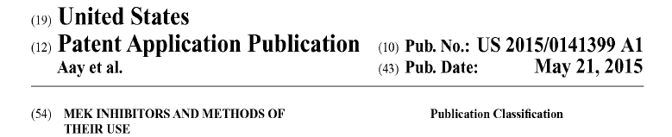
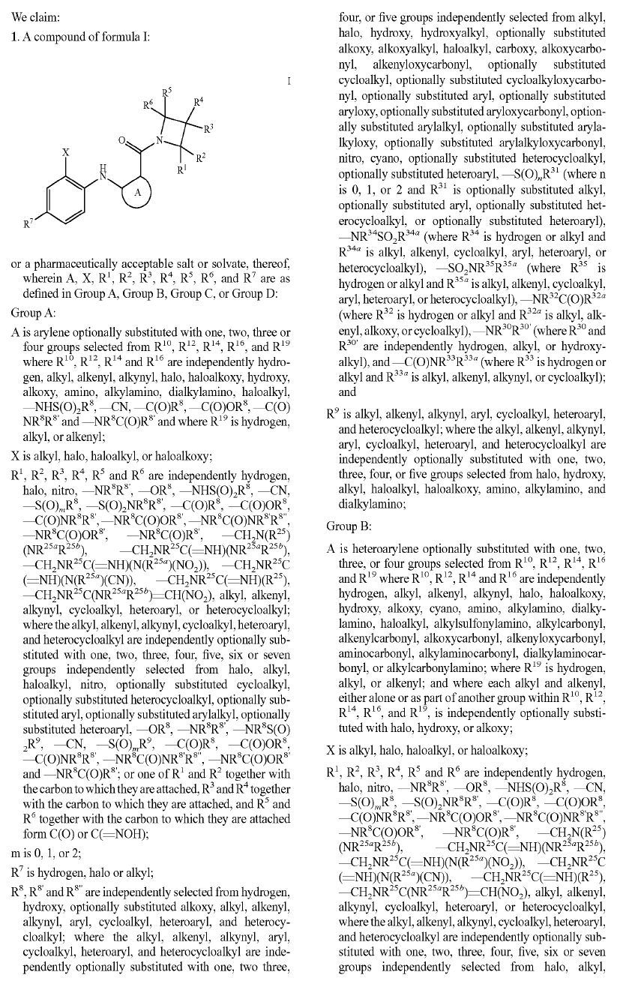
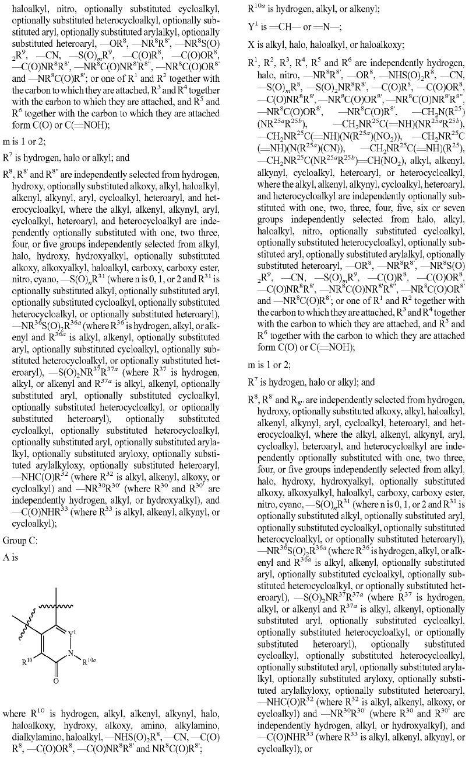
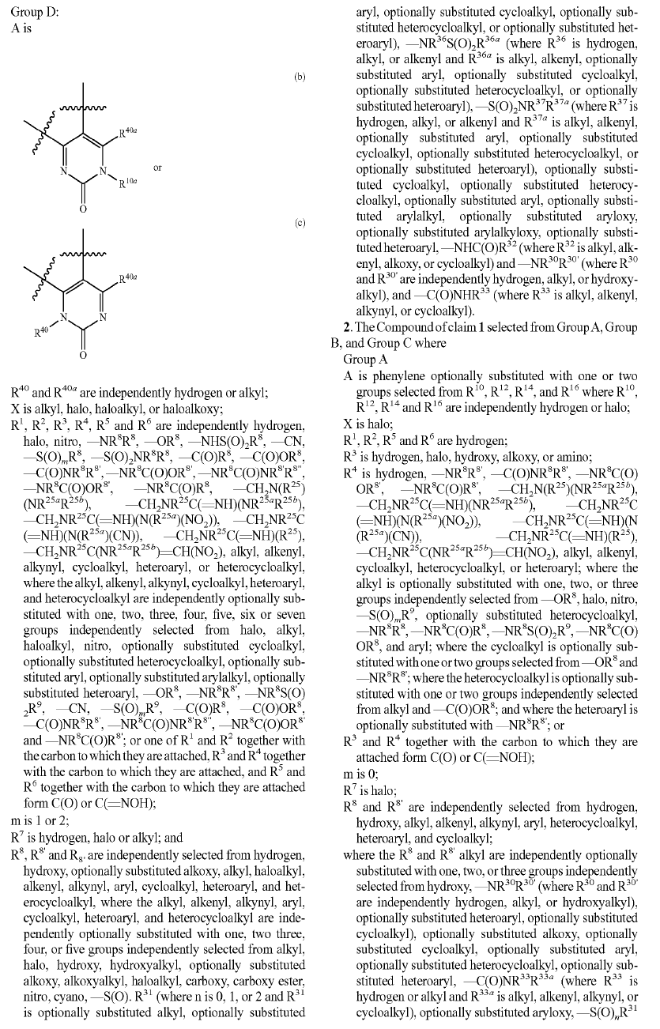

Slide 20

Want to know more?
“What a Chemist Needs to Know About Patents”, SCI, 23 April 2018
“Careers in Ideas” http://careersinideas.org.uk
Email: dsmyth@eip.com
Twitter: @EIP_Elements
Blog: IPAlchemist.com
@IP_Out, @LGBTSTEM
Pronouns: He/Him

Slide 21
Please ask questions

