Slide 1


Science Table Quiz Answers 2016

Slide 2

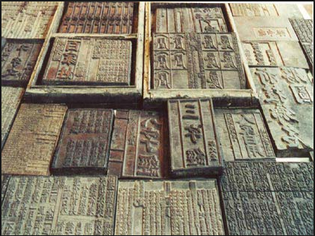
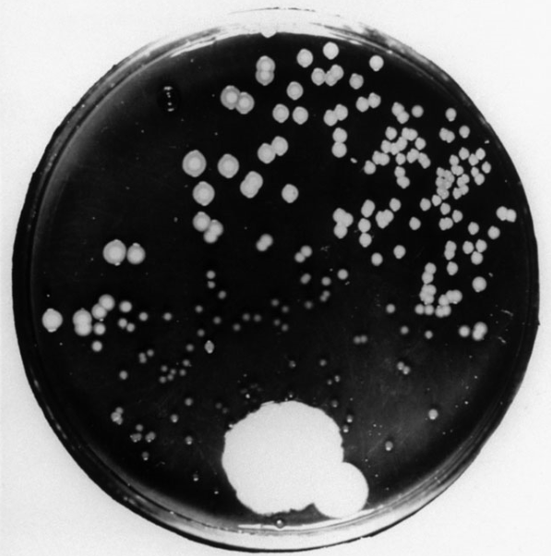
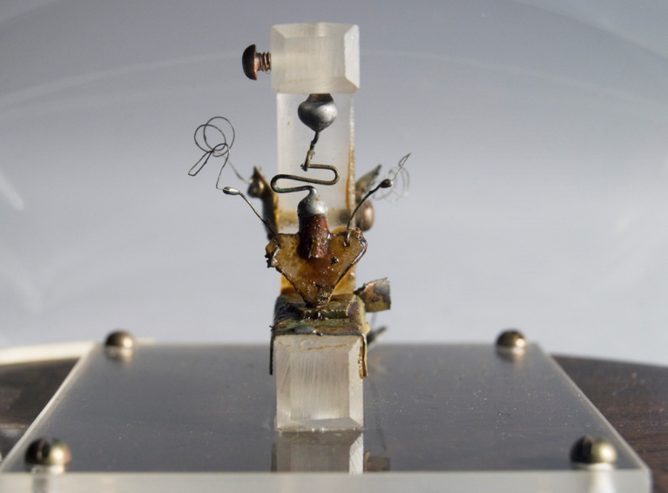
Science Rising: Great Inventions
Central Europe (Slovenia)
Tin
Marco Polo
Steel
Lightbulb
Alexander Fleming
Refrigerators
Bletchley Park
Transistor
Motorola

Slide 3
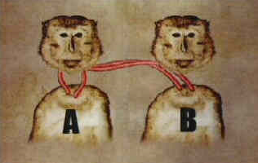
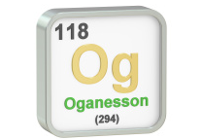
Science and Technology in 1996
Head
2015
Coffee
Radon
Shark
“Sing” – a sort of dawn chorus
Egon Musk
Collagen (to help with bone grafts)
Any of D. Thouless, F. Duncan M. Haldane J. M Kosterlitz, J-P Sauvage, Sir J. Fraser Stoddart, B. Feringa, Yoshinori Ohsumi
400 ppm

Slide 4
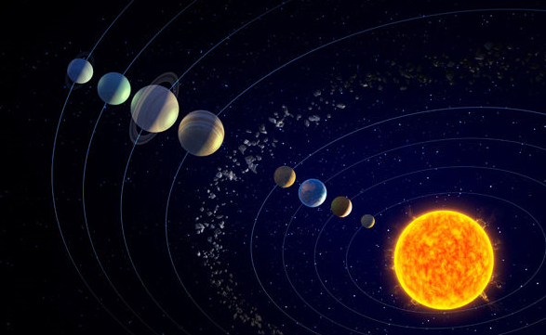
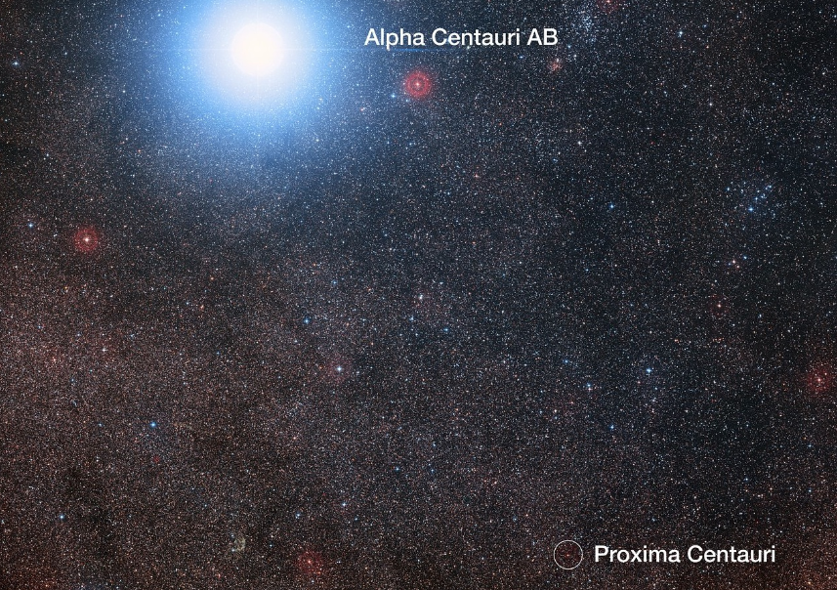
Recent Space Pictures
Pluto
Charon
Ceres
Comet 67P (half mark for Philae or Rosetta comet
Europa (note the geysers)
Proxima Centauri (with planet in habitable zone)
Jupiter (polar view from Juno. Note red spot at the top)
Earth (and Moon, from Juno)
Gravity waves
Mercury

Slide 5
Famous Mathematicians
Euclid
Archimedes
Al Khwarizmi (“Algorithm” comes from his name)
Omar Khayyam
Fibonacci
Li Ye
Copernicus
Euler
Hamilton
Nash

Slide 6
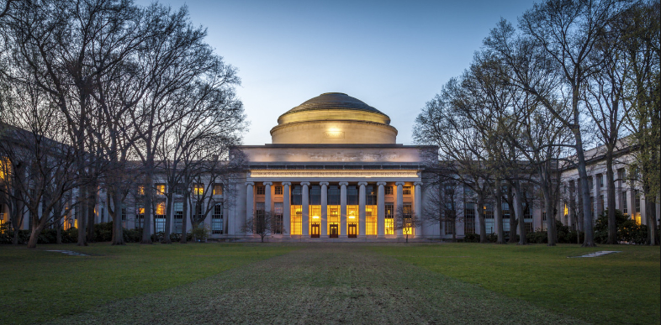
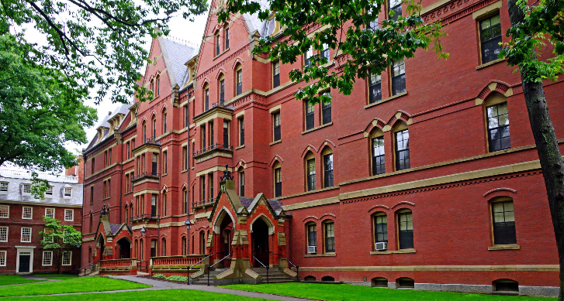
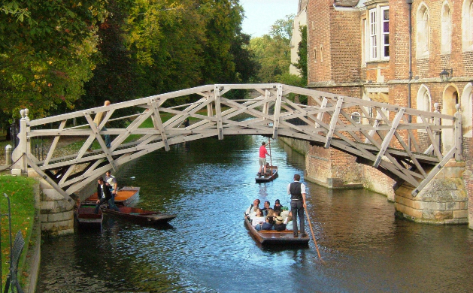
Top 10 Science Universities
MIT
Harvard
Cambridge
Stanford
Oxford
ETH Zurich
(Univ of Calif) Berkeley
Caltech (Calif Inst Tech)
NU Singapore
Tokyo

Slide 7
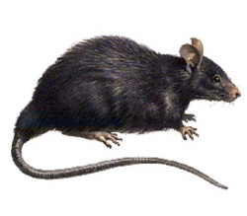
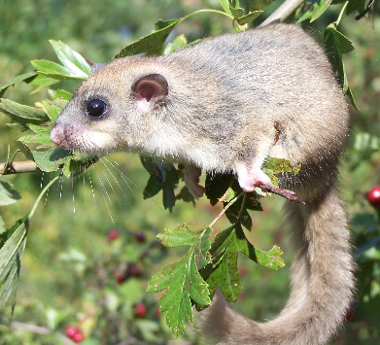
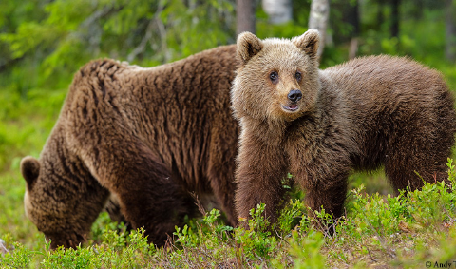
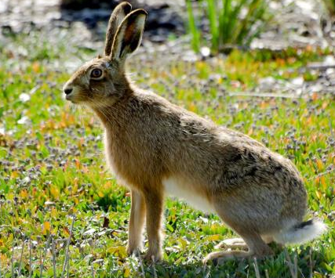
Zoology
Black rat
Edible dormouse
Common frog
Red fox
Red squirrel
Red deer
Grass snake
Pine marten
Brown bear
Hare

Slide 8
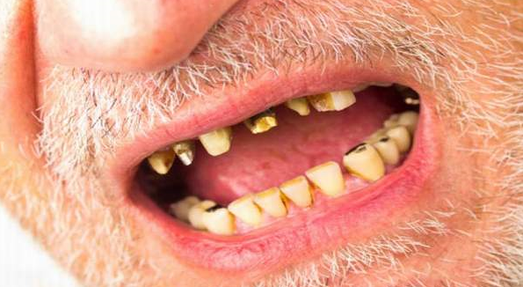

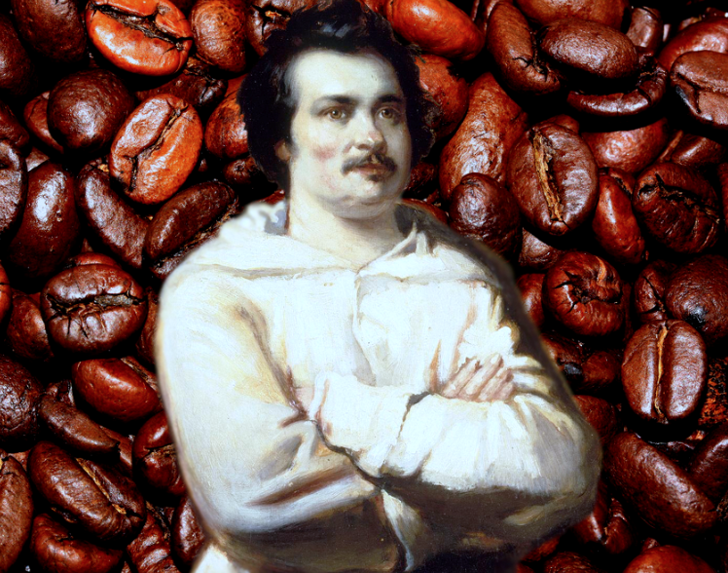
Medicine: Deficiencies & Surfeits
Scurvy (it’s the E number for vitamin C)
Hypervitaminosis A
Vitamin D
Vitamin B1 (thiamine)
Iodine
Cadmium
Potassium
Chocolate (also tea & cola nuts)
Balzac (it was probably heart failure, but he apparently drank 50 cups per day)
Peaches (he probably had dysentery).

Slide 9
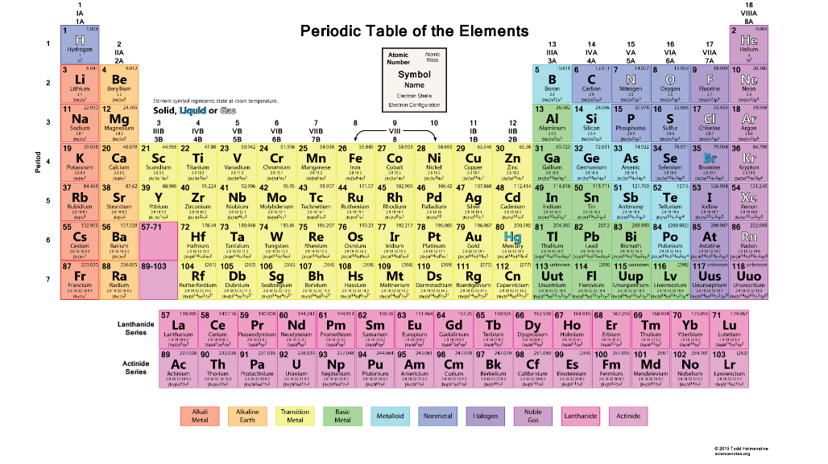
Name the Chemical Elements
Helium
Fluorine
Lithium
Carbon (rough diamonds)
Iodine
Tungsten (an original Edison lamp)
Gallium
Bromine
Neon
Phosphorus

Slide 10
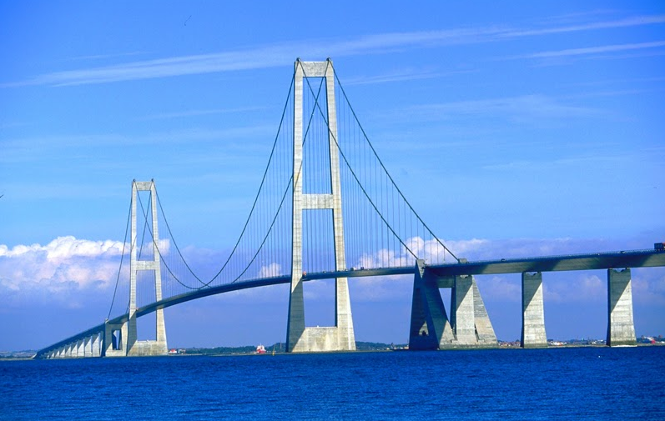
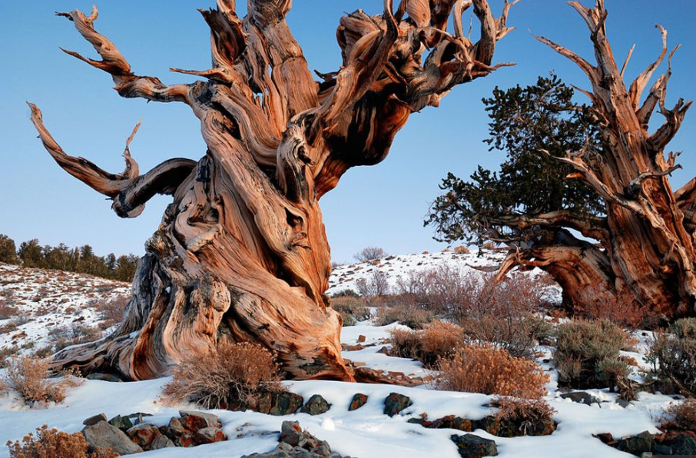
Miscellaneous
Twitter
Denmark (& not between Denmark & Sweden - 3rd longest in world)
Atomic weight
Mandible (mandibula)
46
173
3.1416
(Great Basin) Bristlecone Pine (Pinus langeva)
On account of their Global Warming Potential
The James Webb telescope

Slide 11
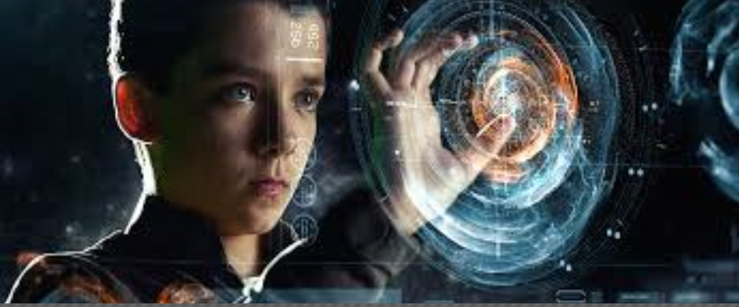
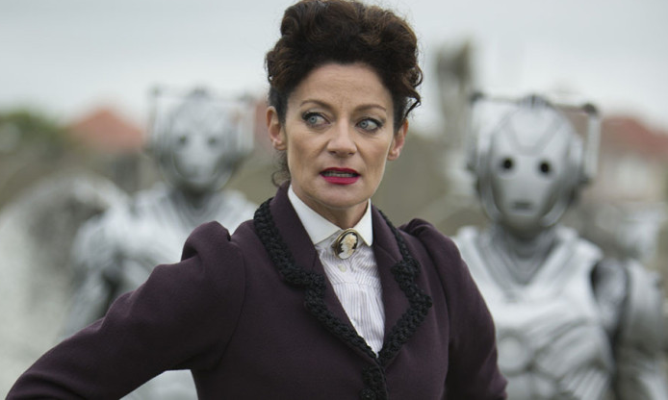
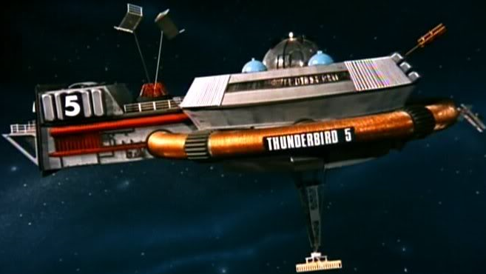
Science Fiction
Ender’s Game
Humans
Benedict Cumberbatch
Frank Herbert
Michelle Gomez
(Star Trek) Beyond
A Space Station
Autoignition temperature of paper.
Creature from the Black Lagoon
The Survivalist

