Slide 1



Science Table Quiz 2016

Slide 2

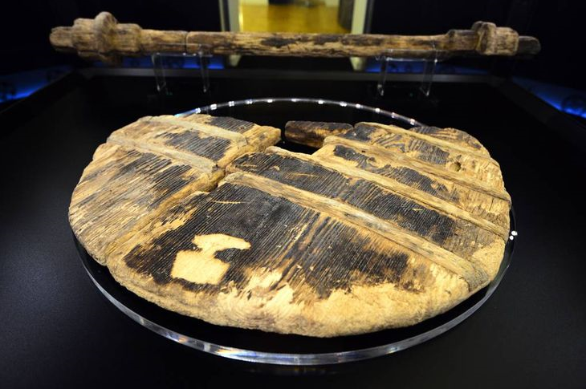
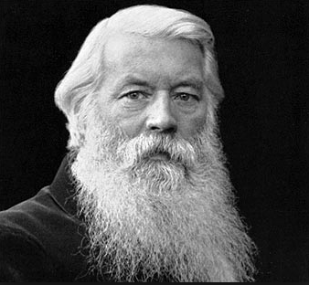
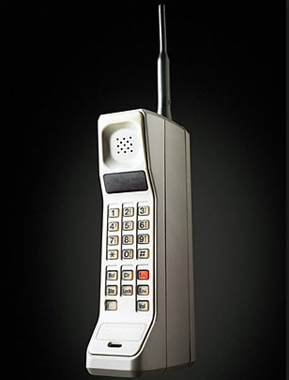
Science Rising: Great Inventions
Where was the earliest known wheel and axle discovered? Egypt, Mesopotamia or Central Europe?
In the Bronze Age, what metal was added to copper to make bronze?
Who brought the idea of the printing press from China to Europe?
The Bessemer Process was used in the 19th century to make what?
Joseph Swan was a key inventor, with Thomas Edison, of what?
Who discovered Penicillin?
Ammonia and Sulphur Dioxide were widely used in which household items until the late 1920’s?
Where was Colossus, an early computer, developed?
William Shockley won the 1956 Nobel Prize for physics for which invention?
The DynaTAC, the first commercial hand-held cell phone was developed by which company?

Slide 3

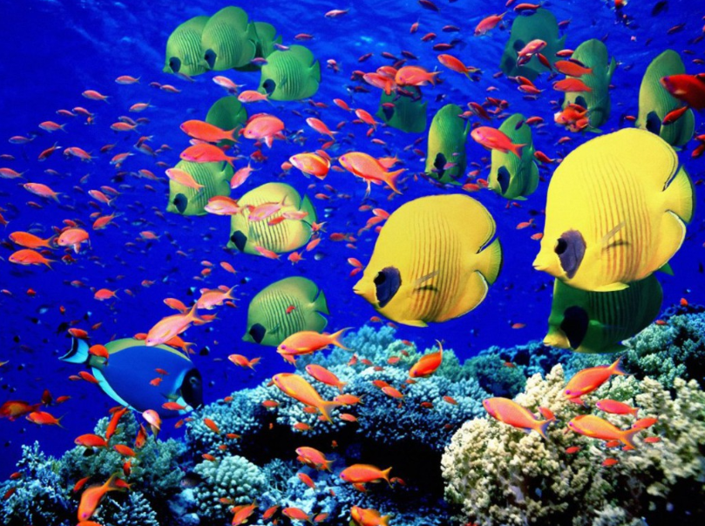
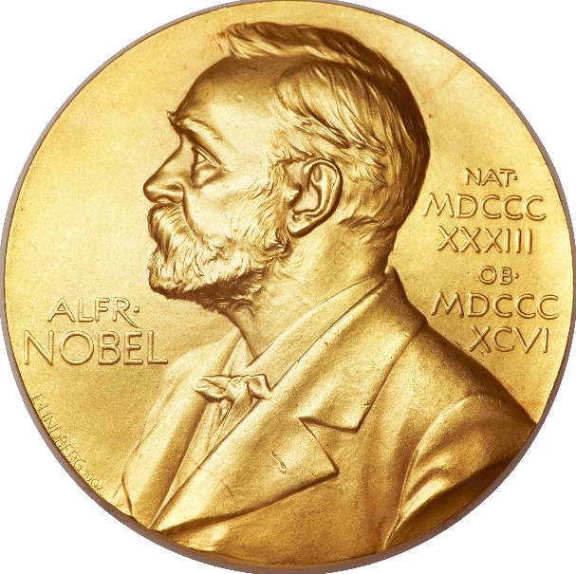
Science and Technology in 2016
January: In China there was the first ever transplant of which body part (on a monkey)?
Which year was the hottest since 1880 (according to NASA)?
April: According to the Univ of Southern California, which drink protects against colorectal cancer?
June: IUPAC named element 118 Oganesson. Which element was it placed below?
August, The Greenland “something” was estimated to be the longest living vertebrate. Name the “something”.
Fish around coral reefs were shown to do what at dawn?
September: which entrepreneur announced plans to transport people to Mars?
Researchers in Trinity College Dublin succeeded in 3D printing which protein?
October: Name any one of the 2016 Nobel prize winners in Chemistry, Physics or Medicine/Physiology
According to the World meteorological Organisation, 2016 is likely to be the first full year when atmospheric CO2 levels stayed above how many ppm?

Slide 4
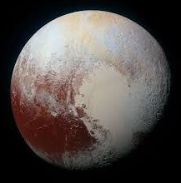
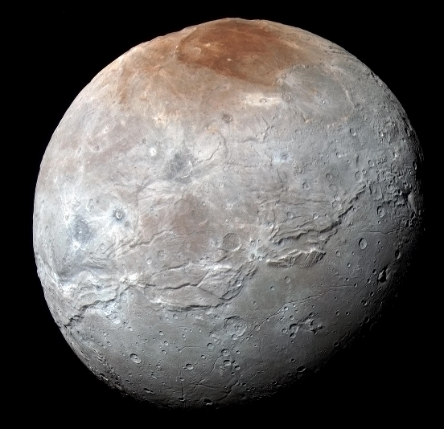
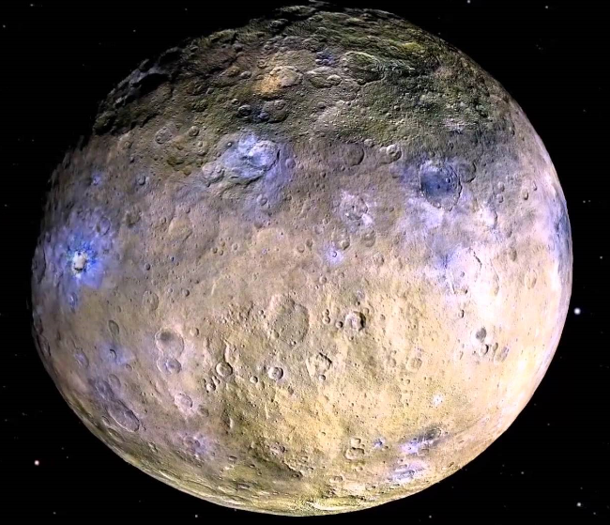
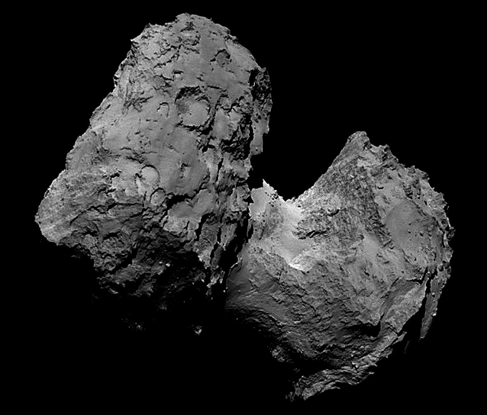
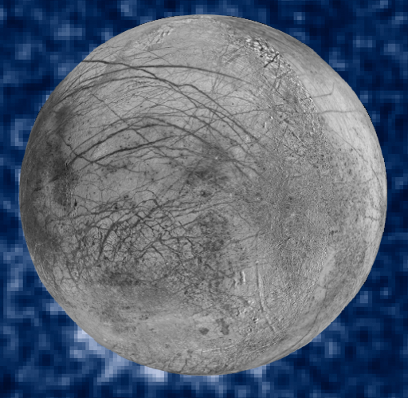
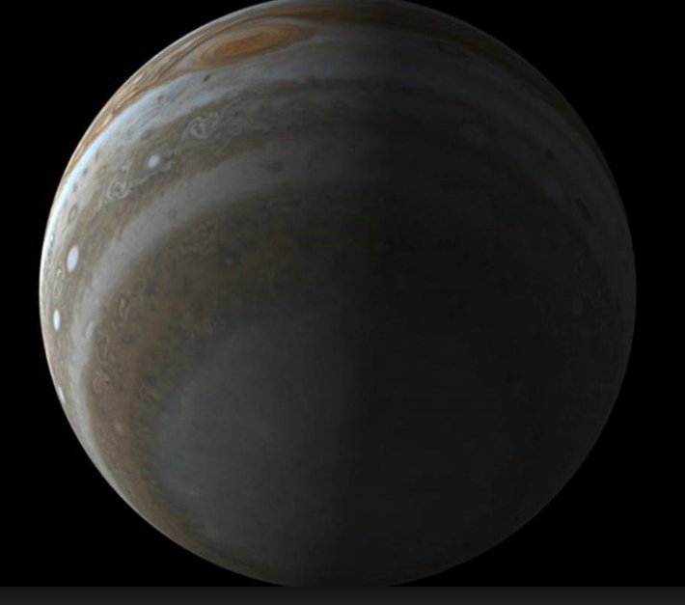
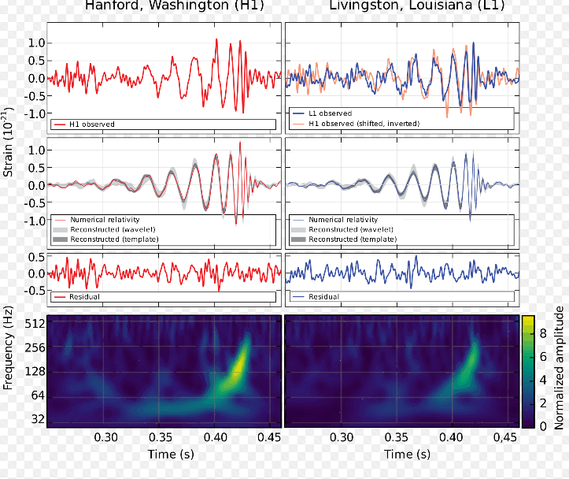
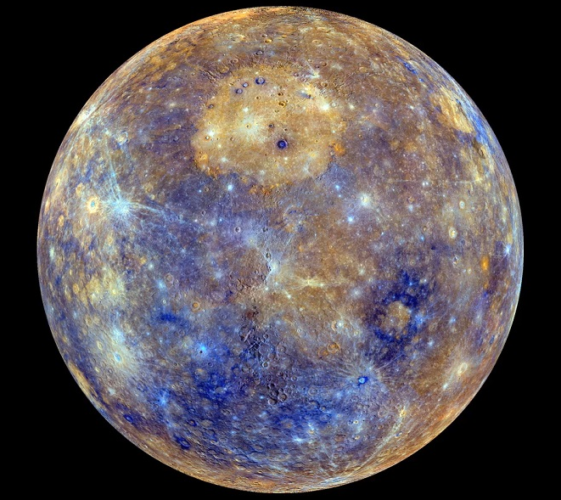
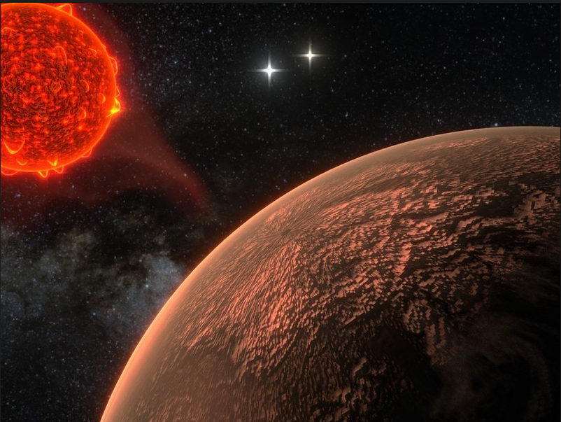

Recent Space Pictures
1
2
3
4
5
6 – Artist’s impression
What is the star?
7
8
What do the
oscillations signify?
10

Slide 5
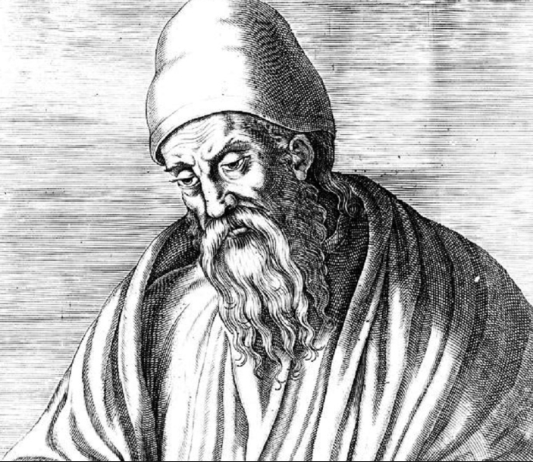
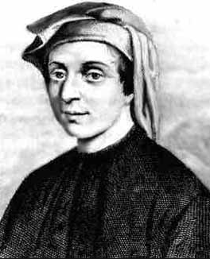

Famous Mathematicians
E….., Alexandrian Greek ca 300 BC
A………, Sicilian Greek ca 220 BC
A.-K…….., Arab ca 800 AD
O… K……, Persian ca 1100
F…….., Italian ca 1200
L. Y., Chinese, ca 1250
C………, Polish ca 1540
E…., Swiss, ca 1750
H……., Irish, ca 1850
N…, America, 20th century, subject of “A Beautiful Mind”

Slide 6
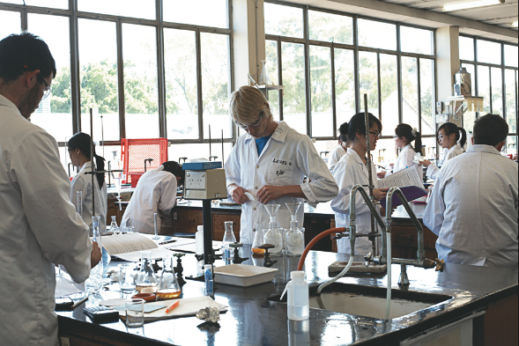
10 Top Science Universities 2015-6
According to the QS (Quacquarelli-Symonds) survey, what are the top 10 global universities for natural sciences? Any order

Slide 7
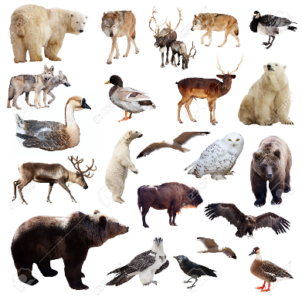
Zoology – common European animals
What are the following animals:
Rattus rattus (no mark if you just put “Rat”)
Glis glis
Rana temporaria
Vulpes vulpes
Sciurus vulgaris – small tree-dwelling rodent
Cervus elaphus – the only cervid native to Ireland
Natrix natrix – Britain’s largest terrestrial reptile
Martes martes – mustelid with yellow throat patch
Ursus arctos arctos
Lepus europaeus – large lagomorph

Slide 8
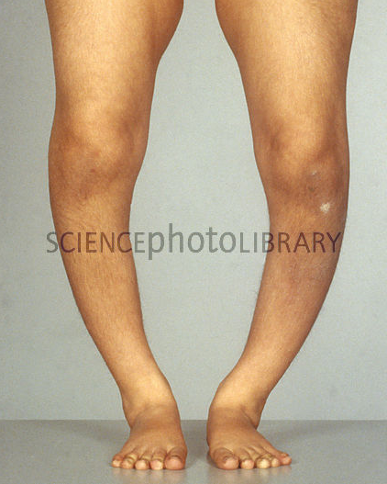
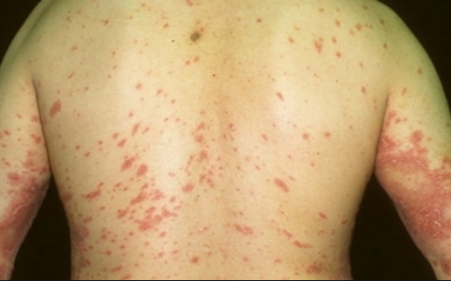
Medicine: Deficiencies and Surfeits
What disease is caused by a deficiency of the food additive E300?
Which condition is caused by an excess of vitamin A?
A deficiency of which vitamin causes Rickets?
And likewise Beriberi?
A lack of which element is associated with thyroid problems?
The Japanese disease itai-itai was due to poisoning by which element? (1912).
Too much of which element is involved in Hyperkalia?
The alkaloid Theobromine can be fatal to dogs & cats, but humans eat quite a lot of it. In what foodstuff is it commonly found?
Which French writer died in 1850, apparently from a coffee overdose?
And King John of England reputedly died of a surfeit of which fruit?

Slide 9
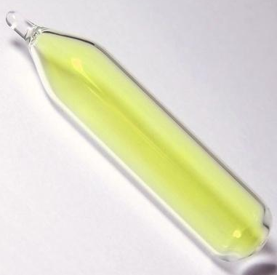
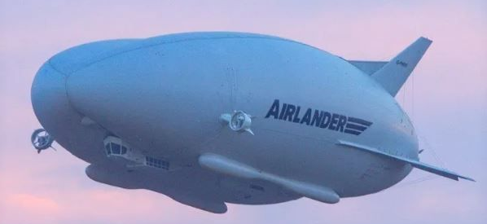
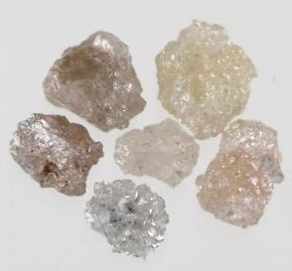
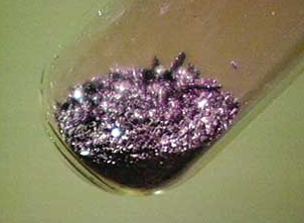
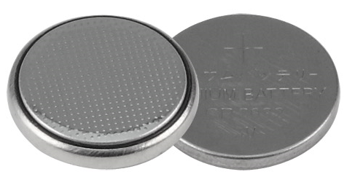
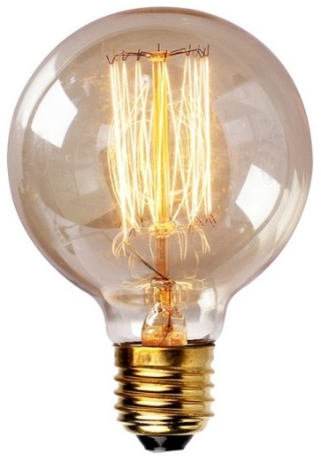
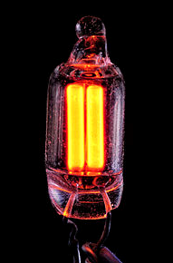
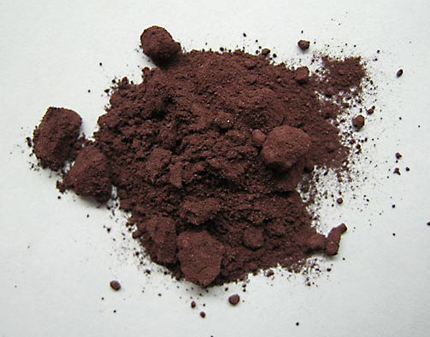
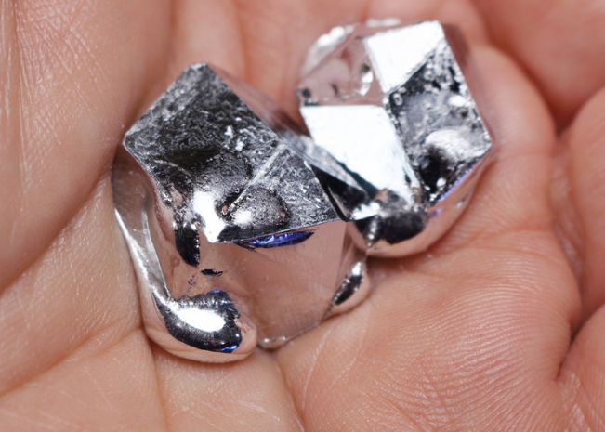
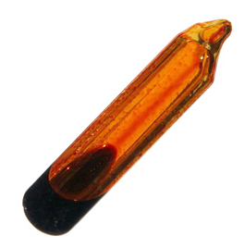
Name the chemical elements
1 - the gas in the airship
2
3 - the anode
4
5
7 – the metal that melts in your palm
8
9 – the gas in the lamp
10
6 – the filament

Slide 10
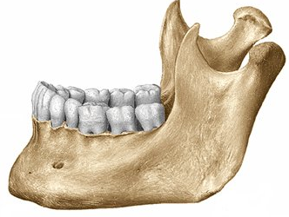
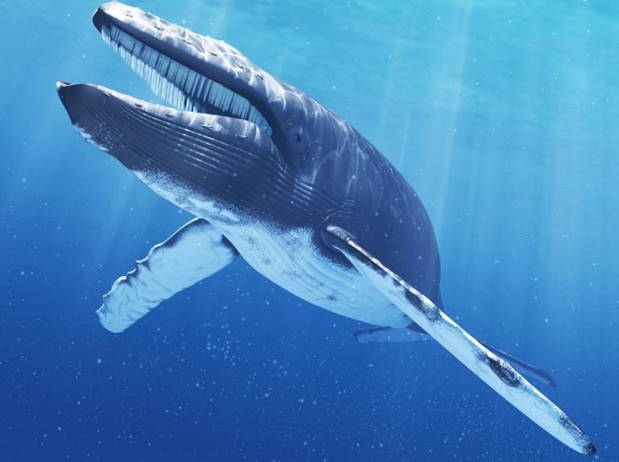
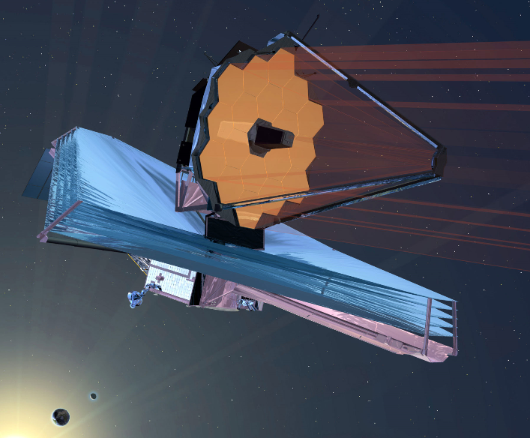
Miscellaneous
Which information service was founded in 2006 by Jack Dorsey, Noah Glass, Biz Stone and Evan Williams?
In which country (or between which 2 countries) is the longest suspension bridge in Europe?
Which parameter is measured in Daltons?
What is the technical or Latin name for the lower jawbone?
What is the molar mass in g/mol of ethanol (to the nearest whole number)?
What is the maximum recorded weight of a blue whale: 173, 223 or 273 tonnes?
Which is the longest living species of tree?
What is pi to four decimal places?
HFC refrigerants replaced CF’s because of their much lower ozone depletion potential. But a treaty to ban them was agreed recently. On what grounds?
Which Space Telescope is scheduled to launch in October 2018?

Slide 11
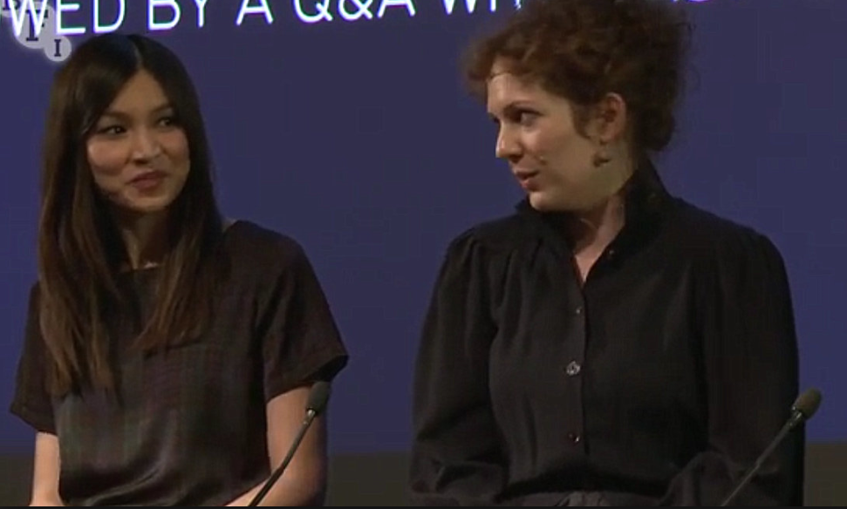
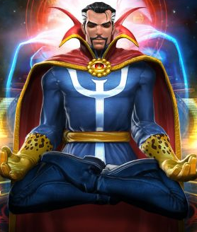
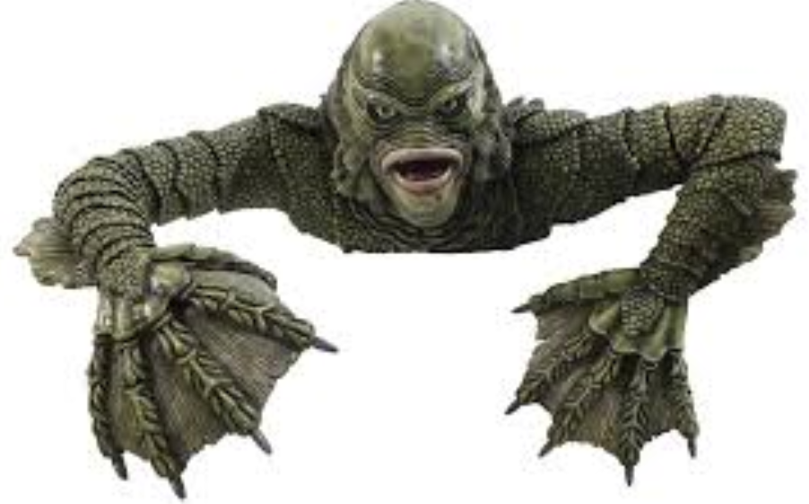
Science Fiction
Which novel by Orson Scott Card about child space pilots was adapted as a film in 2013?
Which 2015-6 TV series, starring Katherine Parkinson, features anthropomorphic robots called “synths”?
Who plays the eponymous “Dr Strange” in this year’s Marvel film?
Who wrote the “Dune” series of novels?
Who plays “Missy”, a female regeneration of The Master, in recent Dr Who series, and “The Lady” in “Gotham”?
What is the title of this year’s Star Trek film?
What type of vehicle/machine is Thunderbird 5?
In Ray Bradbury’s “Fahrenheit 451”, what is the significance of the temperature?
Which 1954 Jack Arnold film featured an amphibious monster?
Which BAFTA nominated film, written & directed by Irishman Stephen Fingleton, released in Ireland this February?

